Slide 1

Understanding Spark Clusters

Slide 2
Spark Cluster Deployment
Locally
Single and multi-threaded
Cluster Deployment
Stand-alone
Ships with Spark distribution.
Easy to install and run. Useful for Testing.
Not meant for prod runs.
YARN
Included in CDH. Production capable.
Mesos
From Berkeley AMP Group.
Initial distribution. Currently being de phased in favor of YARN

Slide 3
Starting Spark
Locally :
$ spark-shell
spark-shell --master local[4]
Standalone Cluster mode:
$ sudo service spark-master start
$ sudo service spark-worker start
$ spark-shell --master spark://<localhost>:7077
YARN
./bin/spark-shell --master yarn-client
./bin/spark-submit --class org.apache.spark.examples.SparkPi \ --master yarn-cluster \

Slide 4
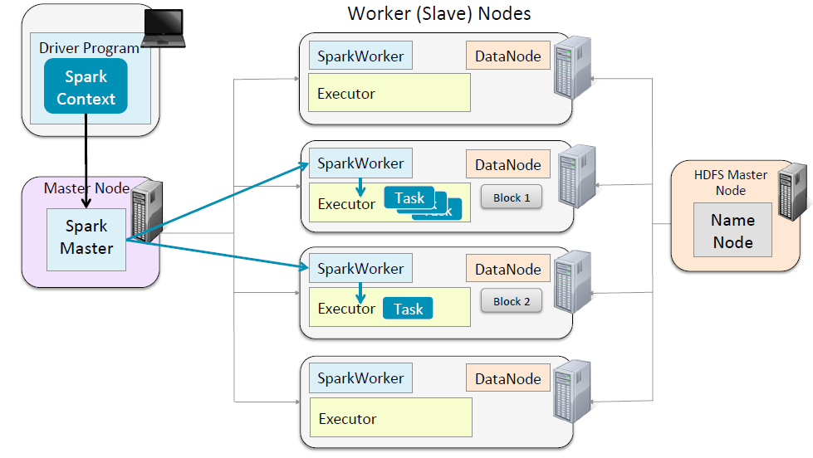
Note: HA option for the Spark Master is available via Zookeeper

Slide 5
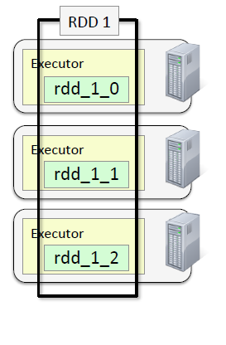
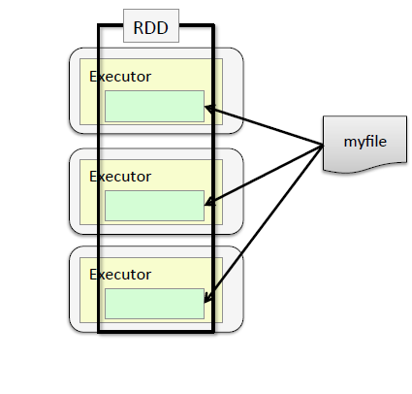
Partitions and RDD
Note: sc.textFile("myfile",3)
Partitions vs HDFS Block

Slide 6
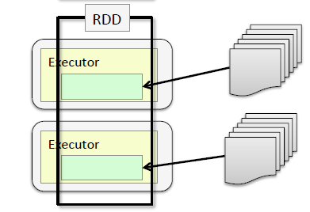
Whole Files
Sc.wholeTextFiles(“<dir>/*”

Slide 7
Why are partitions important?
Controlling partitions will increase efficiency
Shoot for optimal partition level for maximum efficiency
Provide a higher-level computational API
Most APIs in Spark work on elements in RDD
Some work on Partitions
Eg. mapPartitions, mapPartitionsWithIndex
Some operations preserve partitioning
Map, flatMap, filter
Some operations re-partition
Reduce, sort, group
Data: activations/*.xml
Code:spark-core/spark-activations.scala

Slide 8
Monitoring Jobs
http://masternode:uiport
http://localhost:18080
Spark Master: 7077
val data = Array(1, 2, 3, 4, 5)
val distData = sc.parallelize(data)
distData.count()

Slide 9
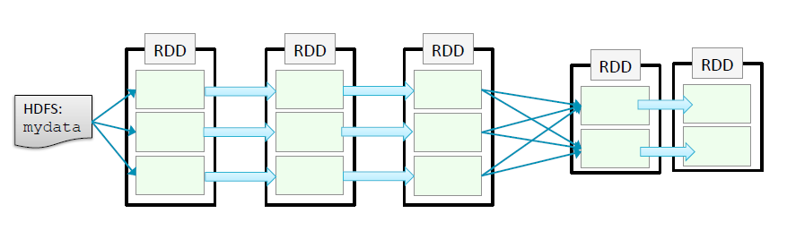
Parallelism in Spark
avglength.scala
// Calculate the average length of the words starting with each letter

Slide 10
Partition & Stage
Operations that run with a single partition is called a stage
Tasks within a stage are pipelined together
An execution plan is created by spark when an “action” is called for.
The Driver program “directs” the execution on the worker nodes.
Stage - 1
Stage - 2

Slide 11
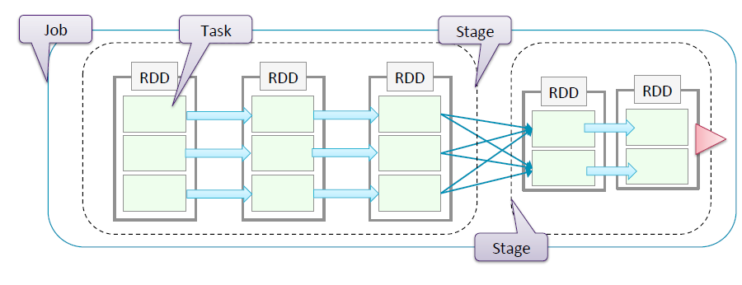
Tasks, Stages & Job
Job- Set of tasks executed by an action
Stage – A set of Tasks executed in parallel in all the nodes
Task- Unit of work that gets executed in one executor node.

Slide 12
How are Stages determined?
Spark constructs a DAG of RDD dependencies
Narrow Operations
Only one child depends on the RDD
No shuffle
Can be collapsed into a single Stage
Eg. Map, filter, union etc
Wide Operations
Multiple Children are dependent on it
Defines a new stage
Eg. reduceByKey, join, GroupByKey()

Slide 13
Controlling Parallelism
Spark.default.parallelism 10
Words.reduceByKey(v1,v2:v1+v2,10)
Less partition = Less parallelism, But
More partition = Data fragmentation

Slide 14
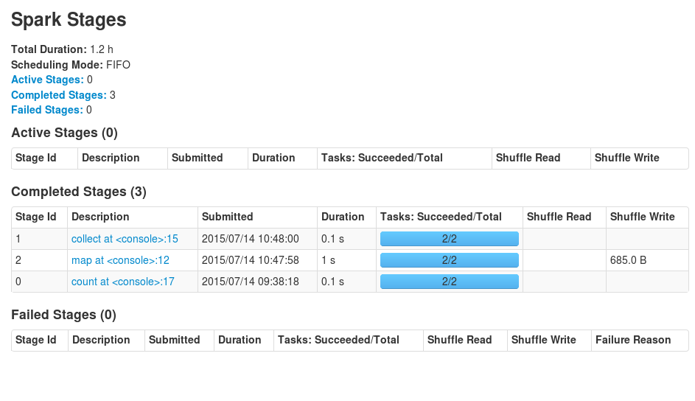
Viewing Stages
http://localhost:4040/stages/
Avglengths.scala

Slide 15
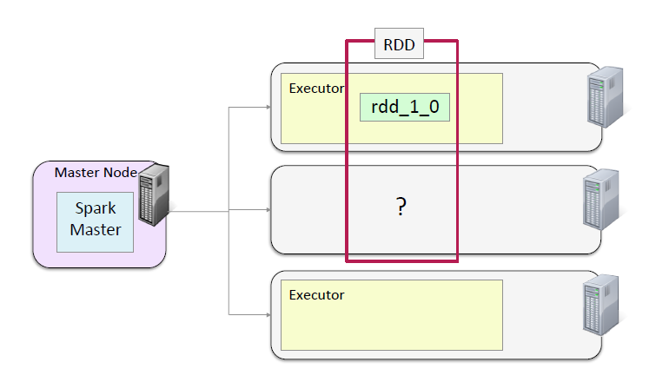
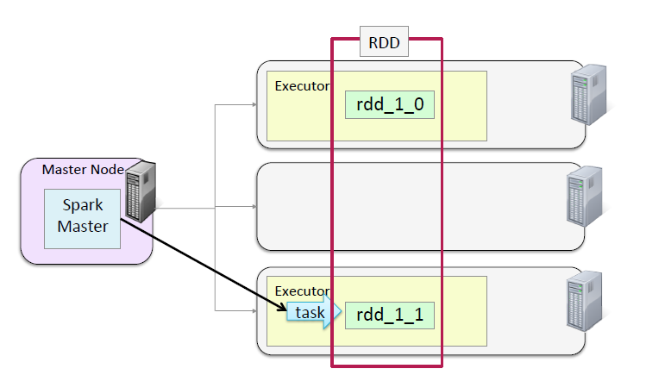
Spark & Fault Tolerance

Slide 16
Spark Persistence Levels
Cache method stores data in memory
Persist
MEMORY_ONLY
MEMORY_AND_DISK (SPILLING)
DISK_ONLY
Replication
MEMORY_ONLY_2, MEMORY_AND_DISK_2
Serialization
MEMORY_ONLY_SER & MEMORY_AND_DISK_SER
Checkpointing
Speeds up recovery of node crashes by persisting RDD lineages in HDFS
Actions.scala
Run models without and with cache option and watch the storage levels in UI (localhost:4040)

Slide 17
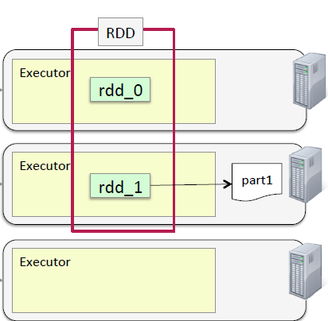
Disk Persistence
Useful when the size of memory is small when compared to the dataset
Disk persisted partitions are stored in local files

Slide 18
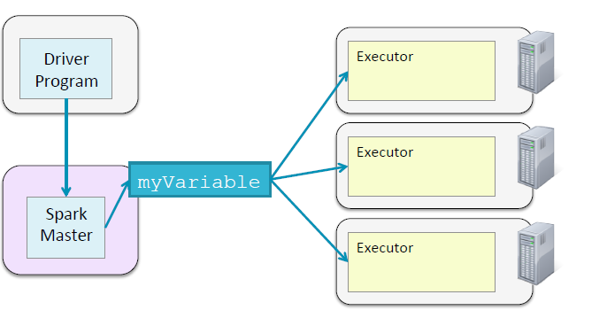
Broadcast
Set by the Driver and “read” by the Executors
Executors CANNOT write to broadcasters
Helps minimize Shuffle
Uses an efficient “peer-to-peer” algorithm for passing broadcast values
Data: weblogs/*
targetModels.txt
Code: Spark-broadcast.scala

Slide 19
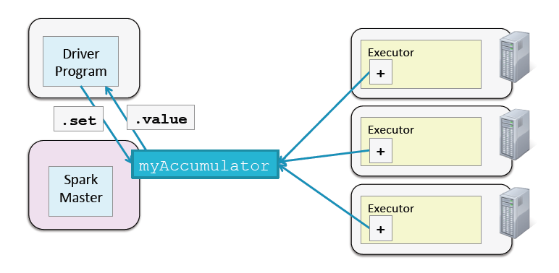
Accumulators
Opposite of what Broadcast does:
Worker nodes “set” the values and the driver reads it.
Code: spark-accumulator.scala

Slide 20
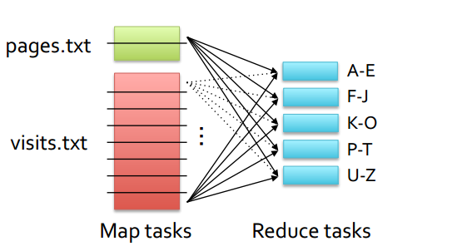
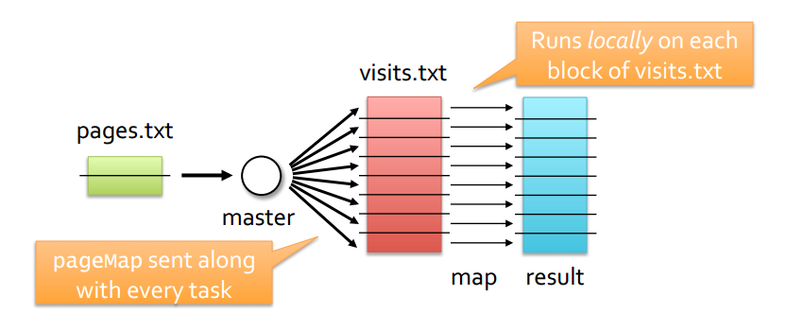
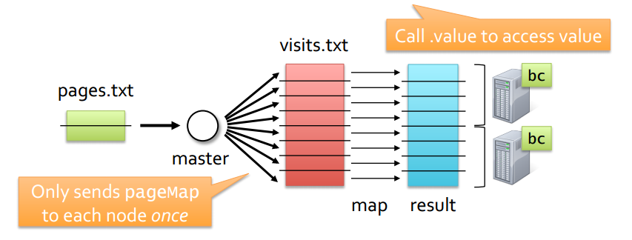
Map Side Joins
http://www.edureka.co/blog/map-side-join-vs-join/
Code: map-join-1.scala
map-join-2.scala

Slide 21
What’s wrong with this line?
rdd.foreach(x => counter += x)

Slide 22
Closures
http://lucybain.com/blog/2014/closures/
Global Variables in Spark
http://stackoverflow.com/questions/5443510/closure-in-java-7

Slide 23
Can Spark be Used as a MemcacheD?

Slide 24


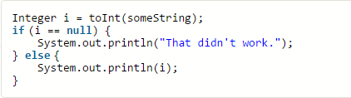
Some, None and Any
Source: http://alvinalexander.com/scala/using-scala-option-some-none-idiom-function-java-null

